Slide 1



AI–Powered Garbage Classification System

Slide 2

Learning Objectives
GOAL

Slide 3


Learning Objectives
♻️ Automate garbage classification into categories: cardboard,
glass, metal, paper, plastic, and trash
🙌 Learn how image classification works using deep learning
models and computer vision techniques.
GOAL
🌱Use metrics like accuracy, precision, recall, and confusion
matrix to assess model effectiveness.
🤖 Develop a custom image classification model using CNN
& pretrained architectures like EfficientNet.
🗑️ Apply techniques such as data augmentation, transfer
learning, and hyperparameter tuning

Slide 4

Problem Statement
Develop an image classification model that sorts waste images into their correct categories. The dataset contains labeled images of garbage in six classes (cardboard, glass, metal, paper, plastic, trash).
The goal is to take a photo of a waste item and correctly classify it
(e.g. identify whether it is plastic, paper, etc.).

Slide 5

Problem Statement
Solution
To address the problem of manual waste sorting, we developed a deep learning-based image classification model using Transfer Learning with EfficientNetV2B2 and custom CNN layers.
The model is trained on a labeled dataset of waste images and is capable of accurately classifying them into six categories: cardboard, glass, metal, paper, plastic, and trash.
An interactive Gradio web interface is also integrated, allowing users to upload waste images and receive instant predictions in real time.
Develop an image classification model that sorts waste images into their correct categories. The dataset contains labeled images of garbage in six classes (cardboard, glass, metal, paper, plastic, trash).
The goal is to take a photo of a waste item and correctly classify it
(e.g. identify whether it is plastic, paper, etc.).

Slide 6
Problem Statement
Solution
Develop an image classification model that sorts waste images into their correct categories. The dataset contains labeled images of garbage in six classes (cardboard, glass, metal, paper, plastic, trash).
The goal is to take a photo of a waste item and correctly classify it
(e.g. identify whether it is plastic, paper, etc.).
To address the problem of manual waste sorting, we developed a deep learning-based image classification model using Transfer Learning with EfficientNetV2B2 and custom CNN layers.
The model is trained on a labeled dataset of waste images and is capable of accurately classifying them into six categories: cardboard, glass, metal, paper, plastic, and trash.
An interactive Gradio web interface is also integrated, allowing users to upload waste images and receive instant predictions in real time.

Slide 7

Tools & Technology
used

Slide 8








Tools & Technology used
Python
OpenCV
Tensorflow
Matplotlib & Seaborn
Core programming language
Image preprocessing and handling
For deep learning model development
For data visualization and evaluation
NumPy & Pandas
EfficientNet
Gradio
Scikit-Learn
Data Manipulation and Processing
Pretrained Model (Transfer Learning)
Interactive Web-Based Interface
For model evaluation metrics

Slide 9
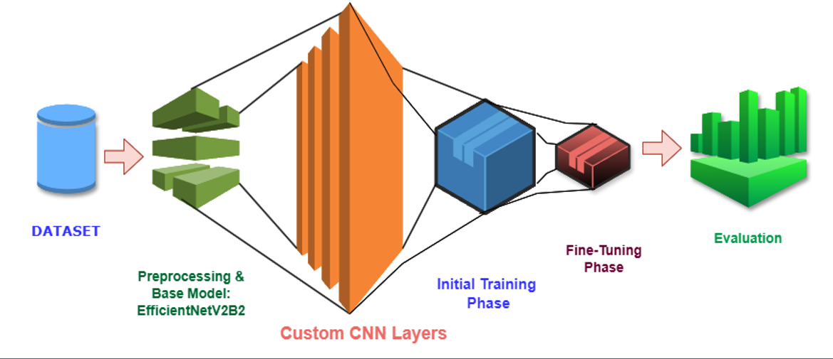
Architecture

Slide 10
Data Preprocessing
2
Images are resized to a standardized input shape, normalized for pixel values, and enhanced using data augmentation techniques such as rotation, flipping, and zooming to improve model generalization.
Data Collection & Exploration
Modal Selection & Training
1
3
We began by using a labeled dataset of waste images and analyzed the class distribution, visualized sample images, and examined basic properties of the data.
We used a pretrained EfficientNetV2B2 model for feature extraction and added custom CNN layers for classification.
Methodology
Modal Enhancement & Retraining
5
To improve accuracy, we fine-tuned EfficientNet layers and experimented with dropout layers, batch normalization, and learning rate adjustments.
Evaluation & Metrics
Deployment
4
The model’s performance was evaluated using accuracy, loss, confusion matrix, and classification report. Training history was also visualized to monitor overfitting and underfitting trends.
6
At last, the trained model was exported for deployment and integration into real-world applications.

Slide 11
Methodology:
Data Collection & Exploration
Data Preprocessing
Modal Selection & Training
1
2
3
Images are resized to a standardized input shape, normalized for pixel values, and enhanced using data augmentation techniques such as rotation, flipping, and zooming to improve model generalization.
We began by using a labeled dataset of waste images and analyzed the class distribution, visualized sample images, and examined basic properties of the data.
We used a pretrained EfficientNetV2B2 model for feature extraction and added custom CNN layers for classification.
Evaluation & Metrics
Modal Enhancement & Retraining
Deployment
4
5
6
The model’s performance was evaluated using accuracy, loss, confusion matrix, and classification report. Training history was also visualized to monitor overfitting and underfitting trends.
At last, the trained model was exported for deployment and integration into real-world applications.
To improve accuracy, we fine-tuned EfficientNet layers and experimented with dropout layers, batch normalization, and learning rate adjustments.

Slide 12
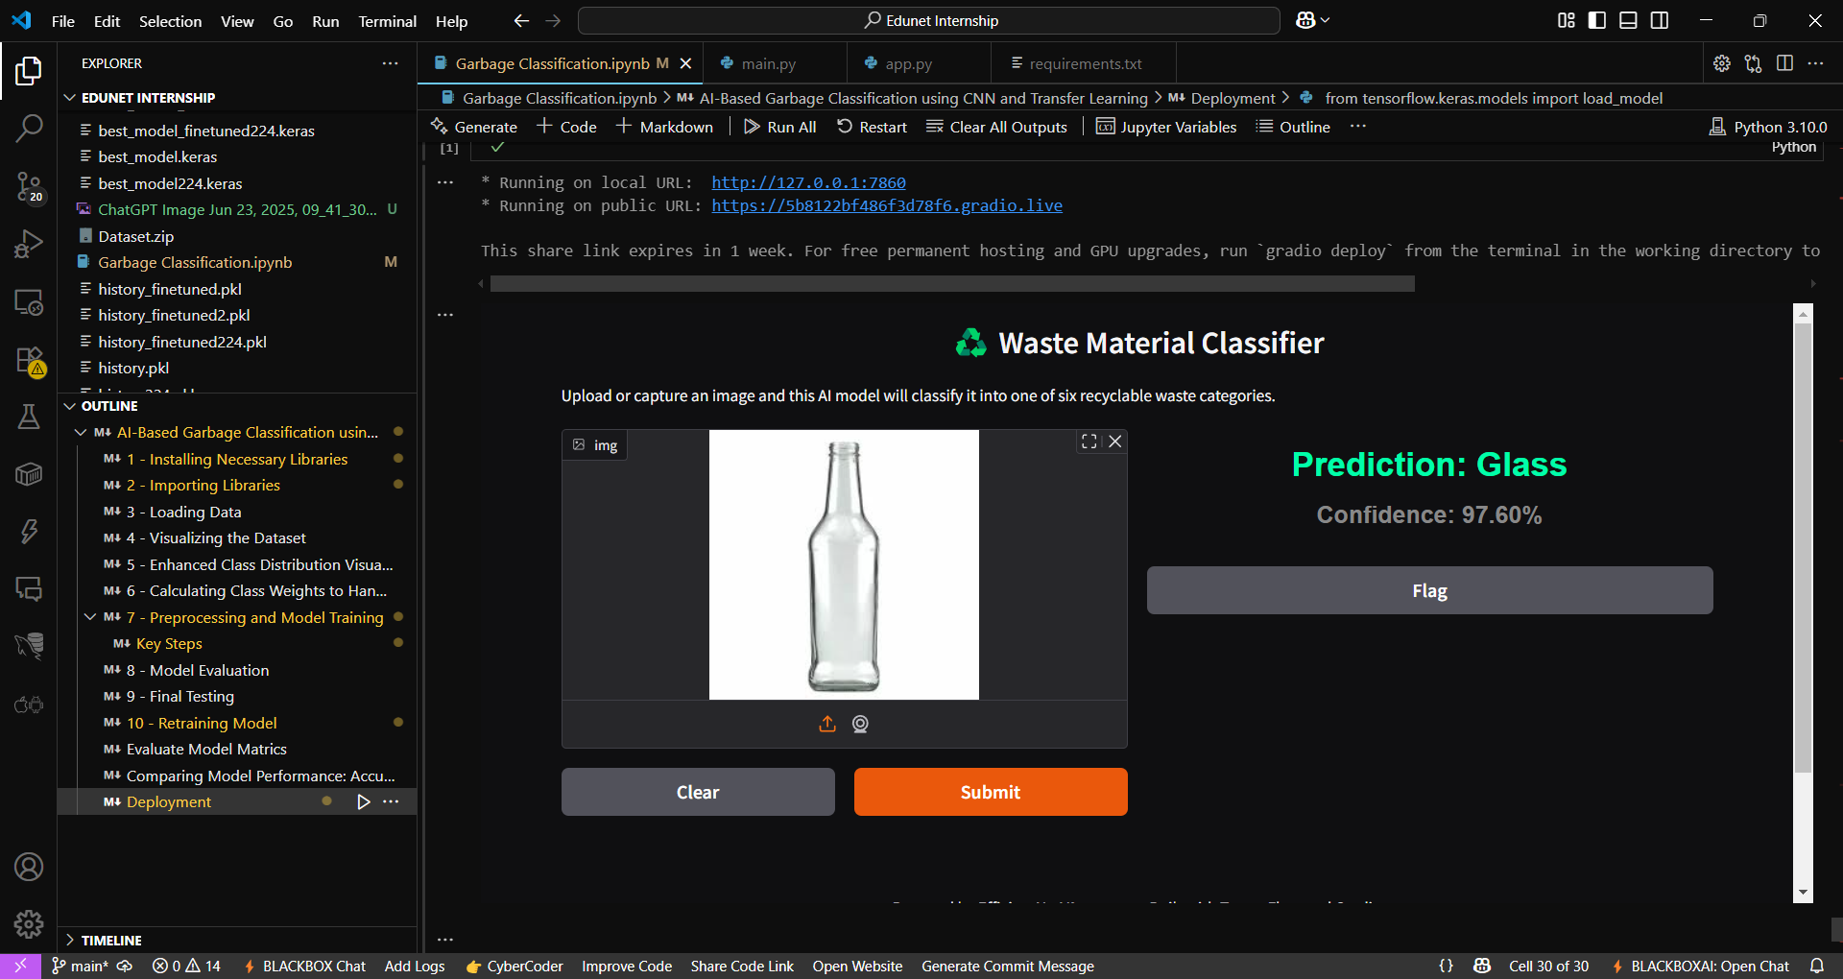
Data Preprocessing
2
Images are resized to a standardized input shape, normalized for pixel values, and enhanced using data augmentation techniques such as rotation, flipping, and zooming to improve model generalization.
Data Collection & Exploration
Modal Selection & Training
1
3
We began by using a labeled dataset of waste images and analyzed the class distribution, visualized sample images, and examined basic properties of the data.
We used a pretrained EfficientNetV2B2 model for feature extraction and added custom CNN layers for classification.
Screenshot of Output:
Modal Enhancement & Retraining
5
To improve accuracy, we fine-tuned EfficientNet layers and experimented with dropout layers, batch normalization, and learning rate adjustments.
Evaluation & Metrics
Deployment
4
The model’s performance was evaluated using accuracy, loss, confusion matrix, and classification report. Training history was also visualized to monitor overfitting and underfitting trends.
6
At last, the trained model was exported for deployment and integration into real-world applications.

Slide 13

Screenshot of Output:

Slide 14
Conclusion:
The project successfully demonstrated the use of deep learning for automatic Garbage classification. By leveraging a pretrained EfficientNetV2B2 model along with custom CNN layers, we achieved accurate sorting of waste images into six categories.
The model was trained and fine-tuned using real-world data, with effective preprocessing and evaluation techniques and achieved 99% Training Accuracy and 95% Validation Accuracy.
This solution has the potential to support smart waste management systems, reduce manual effort, and promote environmental sustainability through AI-driven automation.

Slide 15
THANK YOU
DEVELOPED BY:
Sunil Kumar

